Slide 1

Module 2-Big Data Algorithms
Matrix Vector Multiplication

Slide 2

BIG DATA
Overview
Matrix Multiplication algorithms
Fundamental to many computations, including Page Rank
Source
Leskovec, Jure, Anand Rajaraman, and Jeffrey David Ullman. Mining of massive datasets. Cambridge University Press, 2014.
http://infolab.stanford.edu/~ullman/mmds/book.pdf
4.3.2 of T1

Slide 3
Matrices and Vectors - introduction

Slide 4
BIG DATA
Background: Vectors and Matrices
Vectors
Can be defined as an ordered list of numbers
Visualization
An arrow where the direction of the vector is given by the relative size of the components
Some Common Operations
Addition: v+w
Add components
Scalar multiplication av
Multiply each component by constant
3
P(2,3,4)
4
2

Slide 5
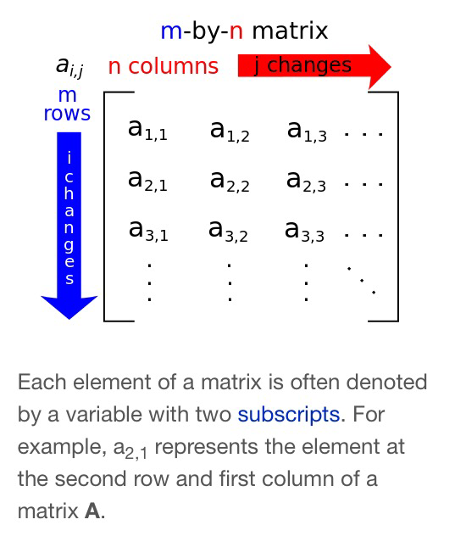
BIG DATA
Matrix
Rectangular array of numbers.
The numbers are called the elements of the matrix.
An mxn matrix has m rows and n columns
Can be considered as a collection of
m row vectors
n column vectors
An nxn matrix is called a square matrix.
Vector can be considered as a
1xn matrix (row matrix)
nx1 matrix (column matrix)

Slide 6
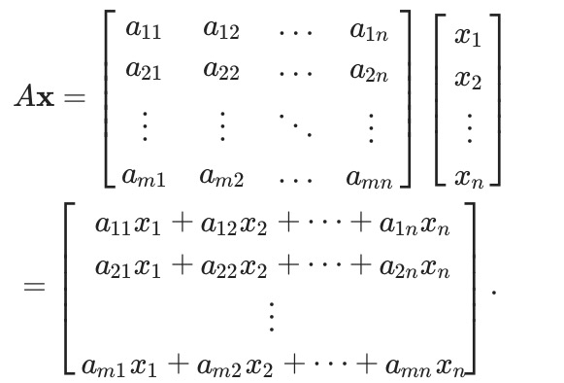
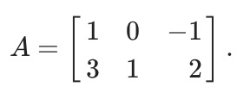

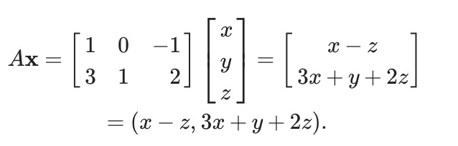
BIG DATA
Matrix Vector Multiplication – Definition
Multiply each row vector of A by the corresponding elements of x and sum
Multiplying a mxn matrix by an n element vector gives an m element vector

Slide 7
BIG DATA
Traditional Representation of Matrices
Typically, matrices are stored as multi-dimensional arrays in programs
int A[10][10]
allocates 100 integers and is accessed as a 10x10 matrix
Space required to store the matrix – = 10x10*sizeof(int)= 100*sizeof(int)=100*4 = 400 bytes.
In general, we need n² integers to store an nxn matrix

Slide 8
Matrix Representation of WWW
Notes:
Exercise
Write a similar program for
Finding the words in a file
For each word, calculate the count
Assume the file contains the string
“To be or not to be”
Hint
This should be done in parallel
In the blue boxes, read in each line in the file
If the line is w1 w2 w3 w4, then output 4 lines w1 1 w2 1 w3 1 w4 1

Slide 9
BIG DATA
How do you represent the pages in WWW?
Page1
Links to
Page 2
Page 3
Page 2
Links to
Page 1
Page 3
Page 4
Consider a sample of the internet that contains 4 pages
- How should we represent this?
Page 3
Links to
Page 4
Page 1
Page 4
Links to
Page 1
Page 2
Pages in the WWW

Slide 10
BIG DATA
Modelling the WWW as a directed graph
Page1
Links to
Page 2
Page 3
1
2
Page 2
Links to
Page 1
Page 3
Page 4
Page 3
Links to
Page 4
Page 1
3
4
Page 4
Links to
Page 1
Page 2
Represented as a directed graph
Pages in the WWW

Slide 11
BIG DATA
Representing the graph as an Adjacency Matrix
1
2
Source
Dest
0 1 1 1
1 0 0 1
1 1 0 0
0 1 1 0
3
4
This is fine for a small graph – 4 pages.
But internet is large – billions of pages.
How much storage will we require?
Directed Graph

Slide 12
Large scale matrix representations

Slide 13
BIG DATA
Representing the graph as an Adjacency Matrix
1
2
Source
Dest
0 1 1 1
1 0 0 1
1 1 0 0
0 1 1 0
3
4
Internet is large – billions of pages.
Note – most of the entries will be 0
Store as a sparse matrix..
Directed Graph

Slide 14
BIG DATA
Sparse Matrix representation
In Big Data, we deal with large matrices
e.g, n will be the order of 10¹⁰ if n is number of web pages
And it will be a sparse matrix
Won’t fit in the memory (DRAM)
Have to store it in HDFS

Slide 15
BIG DATA
HDFS Sparse matrix representation
Store only non-zero elements as a separate record in CSV format
For each element store
<row_number, column_number, value>
As the format
As many entries as there are links
Exercise –Store the graph given on the right into a HDFS CSV file
0 1 1 1
1 0 0 1
1 1 0 0
0 1 1 0

Slide 16
BIG DATA
Solution
1, 2, 1
1, 3, 1
1, 4, 1
2, 1, 1
2, 4, 1
3, 1, 1
3, 2, 1
4, 2, 1
4, 3, 1
As an exercise, try saving this in a file and loading it onto HDFS that you have installed.
0 1 1 1
1 0 0 1
1 1 0 0
0 1 1 0

Slide 17
Matrix Vector Multiplication
Notes:
Exercise
Write a similar program for
Finding the words in a file
For each word, calculate the count
Assume the file contains the string
“To be or not to be”
Hint
This should be done in parallel
In the blue boxes, read in each line in the file
If the line is w1 w2 w3 w4, then output 4 lines w1 1 w2 1 w3 1 w4 1

Slide 18

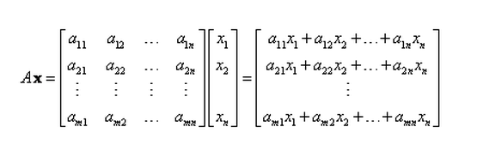
BIG DATA
Matrix Vector multiplication with MapReduce
To multiply an nxn matrix M with an n-element vector v, compute

Slide 19
BIG DATA
Matrix Vector Multiplication with MapReduce
Let us assume that the vector v fits into memory
Vector v is shared by all the mappers
M_{ij} is stored as a CSV file on HDFS and is distributed across multiple nodes
2

Slide 20
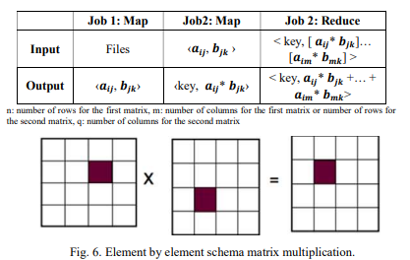
BIG DATA
Matrix Vector Multiplication with MapReduce
MapReduce is a parallel framework for big data, which contains two jobs when is applied on matrix multiplication:
First job: the reduce task is inactive, while the map task is simply used to read the input file and create a pair of elements for multiplication. Second job: the map task implements the multiplication independently for each pair of elements, while reduce job combines the results for each output element.
https://eis.hu.edu.jo/deanshipfiles/conf112262685.pdf

Slide 21
BIG DATA
Matrix Vector Multiplication with MapReduce
map:
Computes the partial product
Uses the key as i → the index into the target vector
output (i, m_{ij}v_{j})
reduce:
Sums all the partial products.

Slide 22
BIG DATA
Working of the MR algorithm – Map Stage
Matrix
Vector
0 1 1 1
1 0 0 1
1 1 0 0
0 1 1 0
5
3
4
2
Note that the key is the index into the vector where this value will contribute
Mapper 1
Mapper 2
Key | Value
1 | 1*3 = 3
2 | 1*5 = 5
3 | 1*5= 5
3 | 1*3=3
4 | 1*3=3
Key | Value
1 | 1*4=4
1 | 1*2=2
2 | 1*2=2
4 | 1*4=4
Notes:
While for illustration, the keys have been vertically divided, such is not necessarily the case as the input need not be sorted in key order.

Slide 23
BIG DATA
Working of the MR algorithm – Reduce Stage
Matrix
Vector
0 1 1 1
1 0 0 1
1 1 0 0
0 1 1 0
5
3
4
2
Mapper 1
Mapper 2
Reducer Input
Reducer output
Key | Intermediate Value List
1 | 2,3,4
2 | 2, 5
3 | 3, 5
4 | 3, 4
Key | Value
1 | 9
2 | 7
3 | 8
4 | 7
Notes:
While for illustration, the keys have been vertically divided, such is not necessarily the case as the input need not be sorted in key order.

Slide 24
BIG DATA
Review Problem
Matrix
Vector
0 0 3 8
0 9 5 0
0 10 0 0
5 0 0 1
1
2
3
4
Assuming rows 1 and 3 are in datanode1 and 2 and 4 are in datanode 2, perform a matrix multiplication using Map Reduce
Show inputs/outputs of mappers/reducers as dicussed in previous slides
Notes:
While for illustration, the keys have been vertically divided, such is not necessarily the case as the input need not be sorted in key order.

Slide 25
Matrix Vector Multiplication - extensions
Notes:
Exercise
Write a similar program for
Finding the words in a file
For each word, calculate the count
Assume the file contains the string
“To be or not to be”
Hint
This should be done in parallel
In the blue boxes, read in each line in the file
If the line is w1 w2 w3 w4, then output 4 lines w1 1 w2 1 w3 1 w4 1

Slide 26
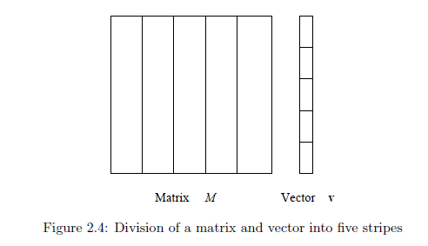
BIG DATA
Matrix-Vector Multiplication using Mapreduce - 2
Case 2: v doesn’t fit into main memory.
Partition M and v into stripes.
The same MapReduce algorithm can be used.

Slide 27
THANK YOU
K V Subramaniam
Dept. of Computer Science and Engineering
subramaniamkv@pes.edu,
ushadevibg@pes.edu

